Slide 1

Estructuras de Datos II
JONATHAN LÓPEZ LONDOÑO
JLOPEZL@UAO.EDU.CO
315 926 5443

Slide 2
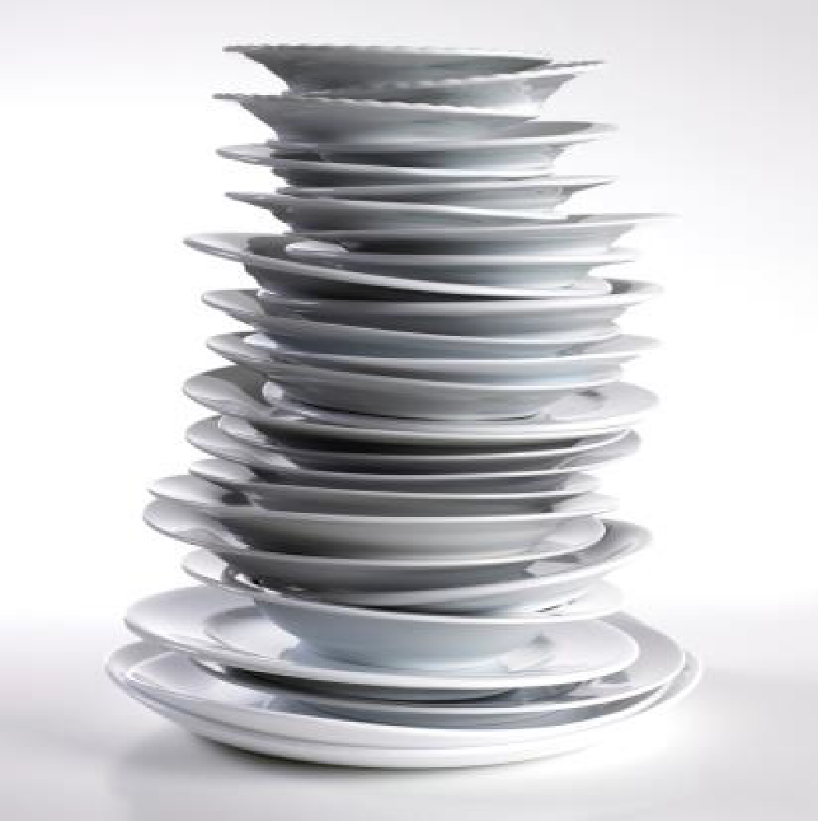
Stacks
Most common example about stacks in programming is:
Imagine that you have a stack of dinner plates to wash after you have dined with your family, and you are responsible to wash this stack of plates.
How would you start it?
Well, the obvious answer is from the top

Slide 3

Stacks
A structure of sequential and ordered elements.
Is based on the principle of last in first out (LIFO). Always the last element that we add, will be the first that we take out

Slide 4
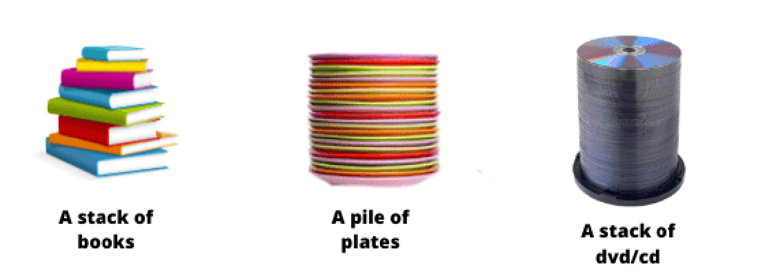
Using Stacks
The history of Web browsers. Each new page that we visit is mounted on top of the previous one and they generate a stack of records, on which we can go back one by one.
Stacks are useful when we need a data structure that we will end up displaying chronologically from most to least recent (such as a list of the latest tweets or articles). In this case, the most recently entered data is the first one that we will retrieve and display.

Slide 5
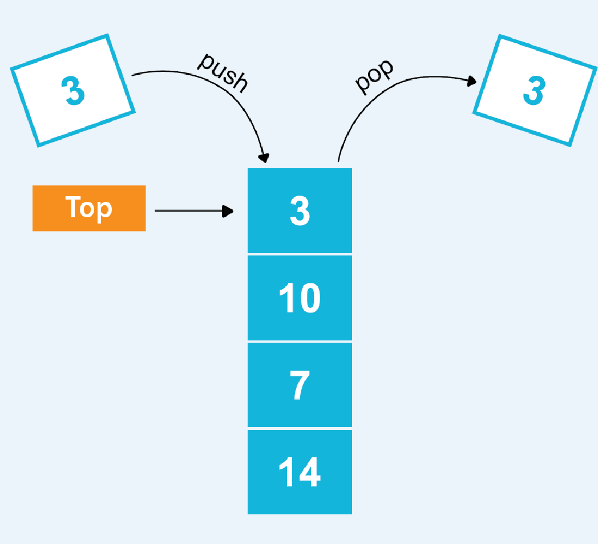
Stacks Methods
A stack must have methods that allow adding new elements, removing them and reviewing them (one or more).
We can make our own implementation and call these methods in any way.
There is an agreed convention of using the following definitions:
push: Adds a new value to the stack, placing it at the bottom of it.
pop: Returns the last value entered on the stack, popping it off the stack.
peek: Returns the last value entered on the stack, without removing it from it.
isEmpty: Returns true if the stack is empty.
size: Returns the number of elements in the stack.
print: Prints the contents of the stack.

Slide 6
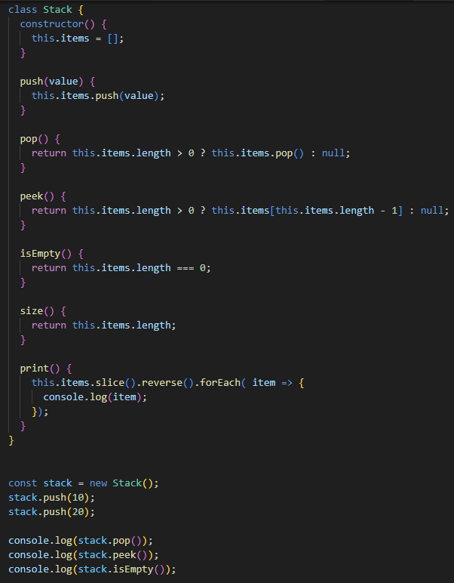
How to implement Stacks?
Peek is the only one method we need to implement, the others come from Prototype in JavaScript

Slide 7

CHALLENGE 04
Create and handle new stack of books. Every book must have its Name, ISBN, Author and Editorial
Fill the stack with some mock data
Create a new project in react, and implements a new screen with a form to create a new book, then add the book to the stack
Print the books stack in screen

Slide 8
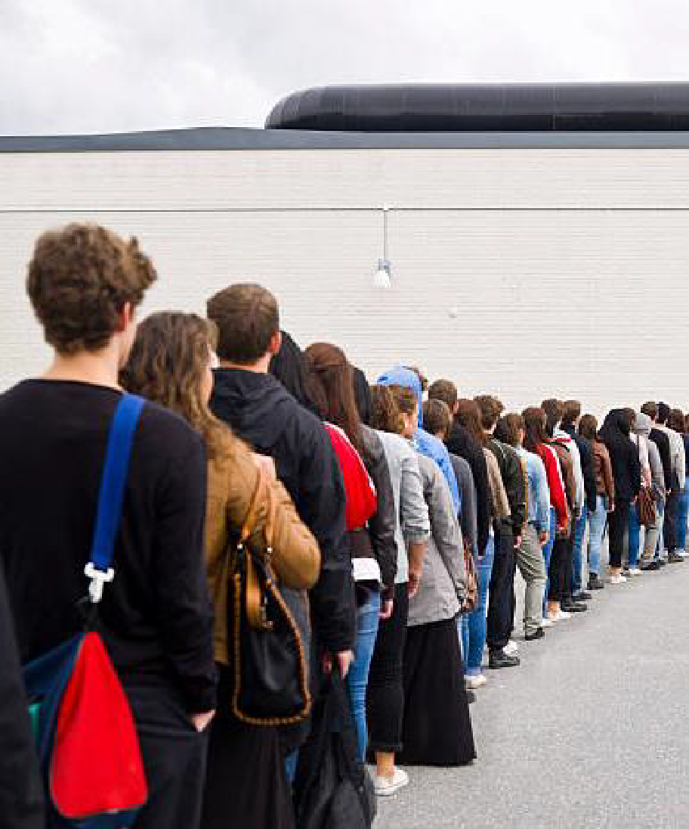
Queues
Most common example about queues in programming is:
Imagine that we have a line of people to enter a specific restaurant.
The last person to get in the line will be the last person to enter the restaurant, depending on the size of the line.
The first person that got into line will be the first person to enter the restaurant.

Slide 9
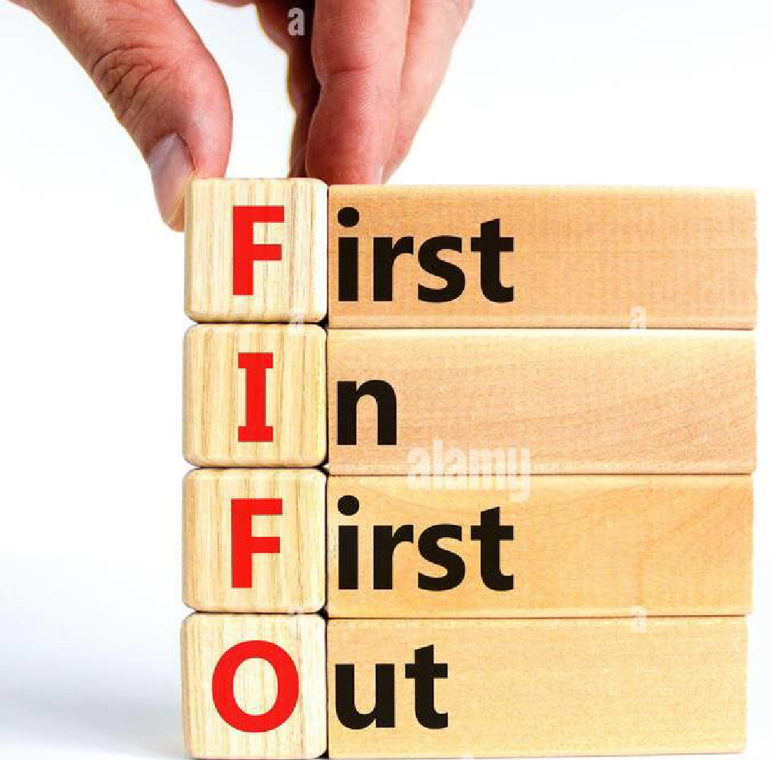
Queues
A structure of sequential and ordered elements.
Is based on the principle of first in first out (FIFO). Always the first element that we add, will be the first that we take out

Slide 10
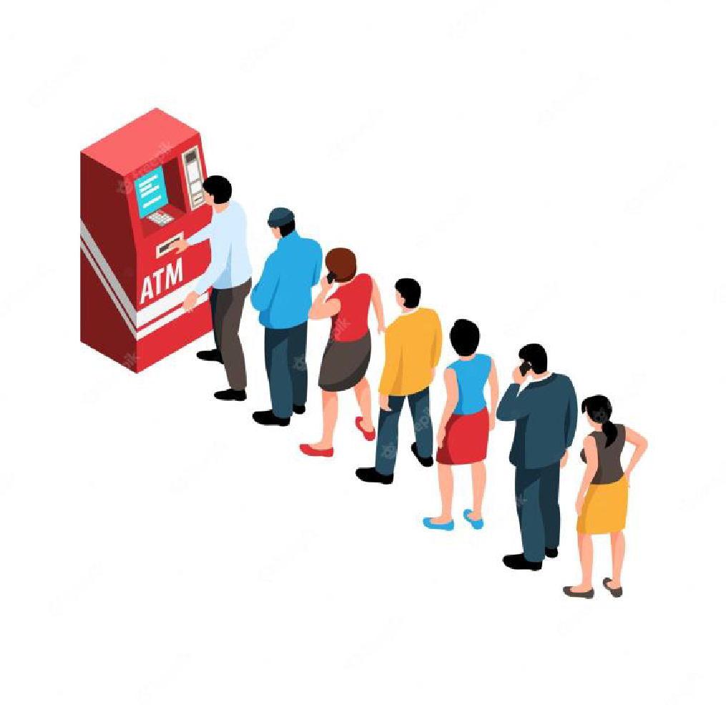
Using Queues
The most common uses of queues today are present in tools and processes that we see every day: task or job queues, such as messaging queues.
In these cases, it is necessary that the first data to enter is the first to leave and is ordered chronologically and in order of arrival.

Slide 11
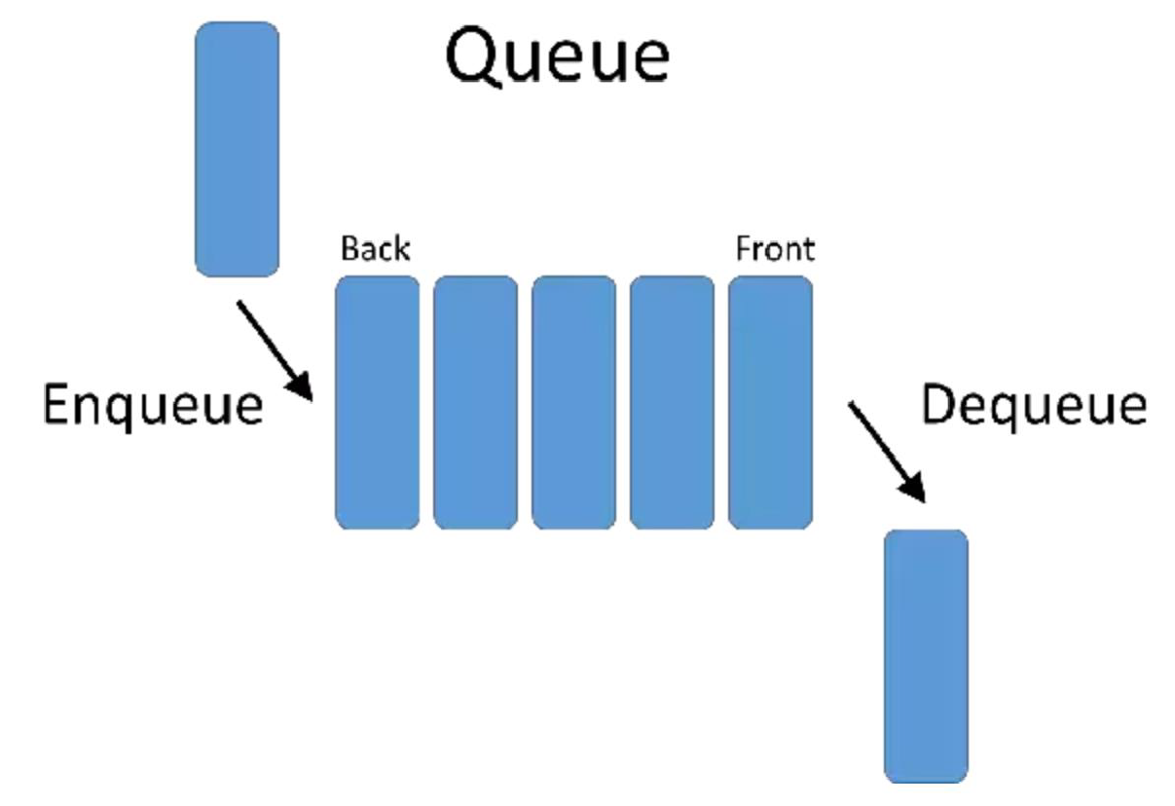
Queues Methods
A Queue must have methods that allow adding new elements, removing them and reviewing them (one or more).
We can make our own implementation and call these methods in any way.
There is an agreed convention of using the following definitions:
enqueue: Adds a new element to the queue, placing it at the end of it.
dequeue: Returns the first element of the queue, removing it from the queue.
peek: Returns the first element of the queue, without removing it from the queue.
size: Returns the number of elements in the queue.
isEmpty: Returns true if the queue is empty.
print: Prints the contents of the queue.

Slide 12
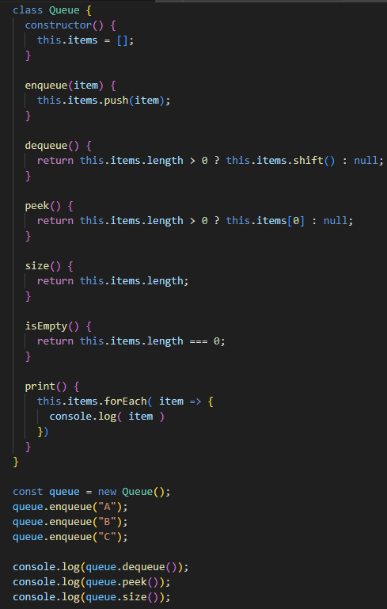
How to implement Queues?
Peek is the only one method we need to implement, the others come from Prototype in JavaScript

Slide 13
CHALLENGE 05
Create and handle new queue of people in one ATM. Every person in the ATM must have its name, withdrawal amount and a random arrival date assigned by the system.
Fill the queue with some mock data
Create a new project in react, and implements a new screen with a form to create a new person, then add the person to the queue
Print the queue in screen according to the arrival date

